Slide 1
www.skvc.lt
LEARNING OUTCOMES APPROACH TO RECOGNITION: Recognising Periods of Study
Centre for Quality Assessment in Higher Education (SKVC)
Qualifications Assessment Division
Kristina Sutkutė
2019

Slide 2
Learning outcomes
Curriculum Design
Assessment
Recognition
Learning and Teaching
Quality Assurance
Concept of Credit

Slide 3
ECTS users’ guide (2015)
Recognition of credits is the process through which an institution certifies that learning outcomes achieved and assessed in another institution satisfy the requirements of one of the programmes they offer.

Slide 4
Kennedy, D. 2006. Writing and using learning outcomes: a practical guide, University College Cork

Slide 5
Recognition of Study Periods
Agreed mobility
Recognition as part of agreed exchange mobility (e. g. ERASMUS)
Other mobility
Recognition of periods of study completed elsewhere
Recognition within the framework of a joint programme
Recognition of a qualification, which can be incorporated into the programme
Eclectic learning
Recognition of prior non formal and informal learning

Slide 6
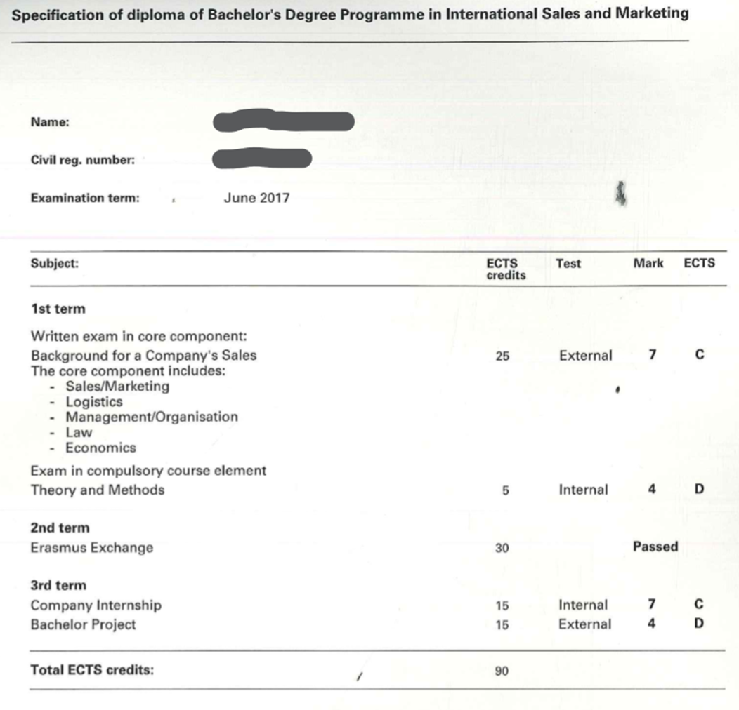
Agreed Mobility
International Business Academy (Denmark)

Slide 7
Agreed Mobility

Slide 8
Agreed Mobility
In selecting subjects for credit mobility
Do not look at individual course units (subjects) and do not look for overlap of the LO,
Accept all credits as long as the programme aims and learning outcomes are not significantly different
Sign a learning agreement
Monitor student progress and adjust the agreement if necessary
Recognise credits in the learning agreement automatically upon return (no re-examination!)

Slide 9
Other mobility
Rigas Technical University, Master degree in Environmental Science
72 credits (60%) out of 120 were recognised

Slide 11
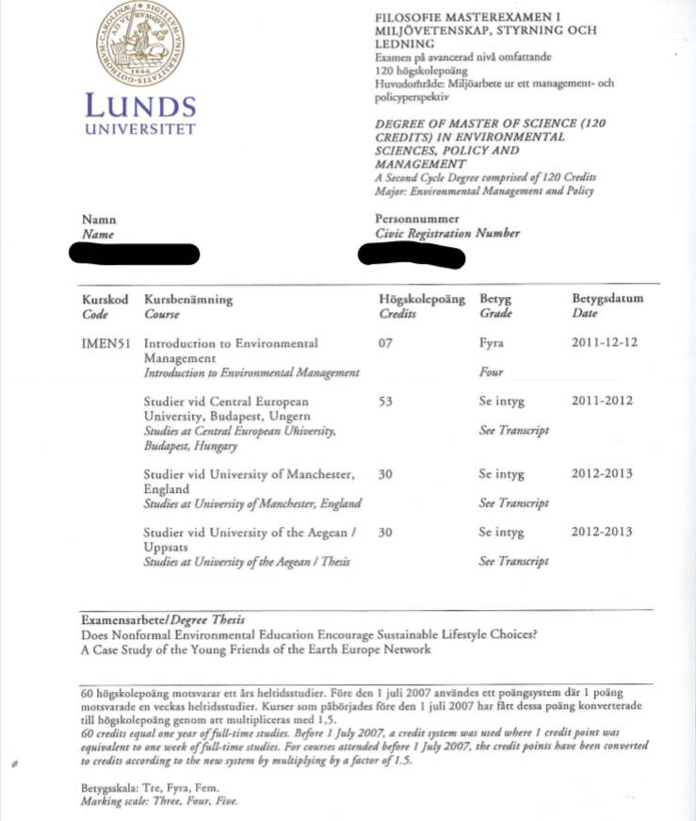

Slide 12
Learning Outcomes Approach in Recognition
Comparability not equivalency
Focus on the overall result (outcome) not the process (input)
No detailed scrutiny of contents and manner of their delivery
This allows to recognise periods of study, which differ in terms of acquisition, but are comparable or complementary in terms of result

Slide 13
Main Tools
European Recognition Manual for Higher Education Institutions (EAR-HEI)
ECTS Users’ Guide (2015)
Diploma Supplement

Slide 14
Thank you
Questions?

